Slide 1
Software Quality Engineering
Week – 7

Slide 2
Agenda (Next Few Lectures)
From integration testing to system testing
Ingredients of system testing

Slide 3
SYSTEM TESTING

Slide 4
Unit and Integration Testing
Unit testing
Control flow
Data flow
Domain testing
– …
Integration testing
Testing
Components interaction
Pass data correctly
Function cohesively

Slide 5



From Integration to System Testing
Unit Testing Techniques
1. CFG
Integration Testing System Testing
Techniques
1. MM Path
Techniques
Specification-based
Model-based techniques
2. DFG
Techniques on the boundary
Techniques on the boundary
2. State-Machine
Exit Criteria
Specific Coverage
Confidence Crit.
Exit Criteria
1. Specific
Coverage Crit.
Exit Criteria
1. Specific Coverage Crit.
Development Manager
Tester₁ Tester₂
…
Tester _{n}
Quality Assurance
Developer₁
PM
Developer₂
…
CM
Developer _{n}
Techniques on the boundary

Slide 6
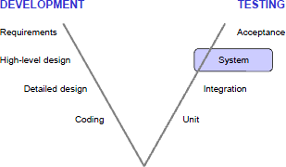
Lifecycle (revisited)

Slide 7
System Testing
Assumption
Unit level testing is performed
Integration level testing is performed
Therefore, individual modules are working correctly
System level focus
Functionality based on Multi-modules
External interfaces
Non-functional aspects, e.g.,
Security
Recovery
Performance
Operational and user business process requirements

Slide 8
System Testing
The process of testing of an integrated hardware and software system to verify that the system meets its specified requirements
verification: conformance to examination and provisions of objective evidence that specified requirements have been fulfilled
IEEE Definitions

Slide 9
System Testing – another definition
Testing to confirm that all code modules work as specified and that the system as a whole performs adequately on the platform on which it will be deployed
Testing conducted on a complete, integrated system to evaluate compliance with specified requirements.

Slide 10
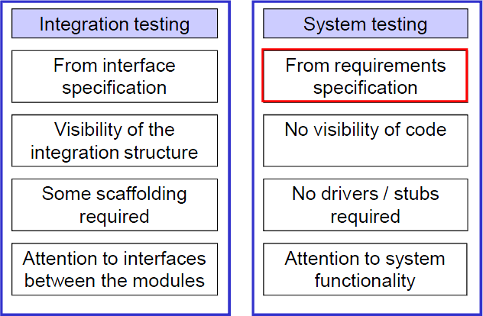
System Testing vs. Integration Testing

Slide 11
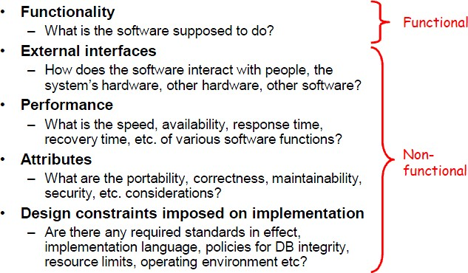
Requirements Specifications
IEEE Definitions

Slide 12
Aspects of System testing
Functional aspects
Business processes
System goals
Non-functional aspects
Load, Stress, Volume
Performance, Security, Usability
Storage, Install-ability, Documentation,
Recovery, …
– …
There could be specific functional as well as non- functional requirements

Slide 13
System Testing – Functional Aspects
Based of requirements / specifications
System models
Context diagrams
ERD
Design documents
Our Focus while deriving test cases
Data
Action
Device
Event

Slide 14
System Testing – Non Functional Aspects
We identify non-functional user requirements with the specifications
Local regulations e.g.,
Each computer in UK must have a warning displayed for user awareness
That the system usage could be harmful under certain conditions e.g., disconnect power before opening
Standard SOPs
We create test cases

Slide 15
Load Testing
System is subjected to statistically calculated load of
Transactions
Processing
Parallel connections
Etc.
Test Case format
It is a setup
Mimicking real life boundary situation

Slide 16
Stress Testing
Form of Load testing
The resources are denied
Finding out the boundary conditions where the system would crash
Finding situations where system usage would become harmful
We test the system behavior upon lack of resources
Test Case format
It is a setup
Mimicking real life boundary situation
Bugs are not (normally) repaired by reported to
the end user for avoidance
example

Slide 17
Performance Testing
We study the performance requirements, e.g.,
Response time
Worst case, best case, average case time to complete a specified set of operations, e.g.,
Transactions per second
Memory usage (wastage)
Handling extra-ordinary situations
Test Case format
It is a setup
Simulation

Slide 18
Volume testing
We test if the system is able to handle expected volume of data, e.g.,
Backend e.g., PRAL
Affiliated resources, e.g. ZEROX printers
Word document having 200,000 pages
We need to measure and report to user
System boundaries with respect the volume or capacity of its processing
Test Case format

Slide 19
Security testing
We want to see if
Use cases are allowed
Misuse cases are not allowed
Aimed at breaking the system
Test cases format
Specific situations
SQL injections
Network security features

Slide 20
Usability and GUI Testing
Verifying if
HCI principles are properly followed
Documented and de facto standards are met
Uses
Scenarios
Questionnaire
User activity logs
Inspections
Examples of Test cases
Lower part of each website
Every windows OS based application

Slide 21
Other forms of testing
Storage testing
Install-ability testing
Documentation testing
Recovery testing
…

Slide 22
Summery

